Slide 1

Stage 7 XY Factor Course Designer: Eric Beerbaum
Carbine: 16 Handgun: 16
The start position is feet touching either start stick. Handgun loaded and holstered. Carbine either loaded, stock touching belt, safety on OR staged loaded, safety on on the table(wrists below belt in this case).
On the audible start signal engage targets from within the shooting areas.

Slide 2
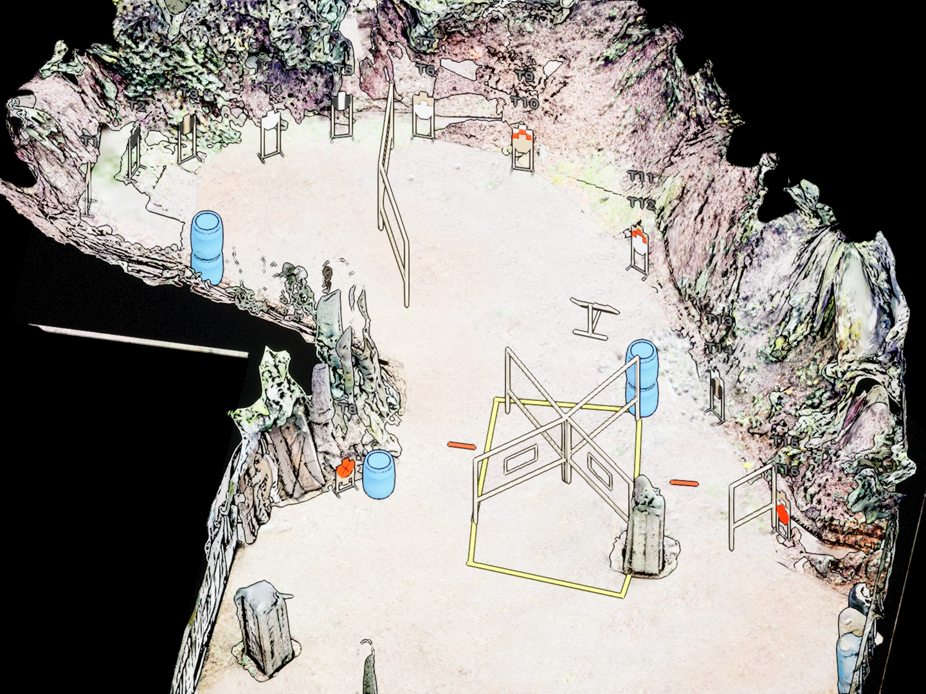
 | Stage 7 XY Factor Course Designer: Eric Beerbaum

